Slide 1

Loan Decision Modeling
By Marcos Dominguez

Slide 2
Project Idea
Predicting credit default risk of loan applicant
Features: 771 columns of anonamized, numerical data
Target: 0-100, default amount
0 → no to very low loan loss: approve loan
>0 → some to very high loan loss: decline loan

Slide 3
Workflow of data collection and modeling
Data size: 100k x 771 dataframe
Kaggle competition: Loan Default Prediction
Imperial College of London
Kaggle Dataset
Classification
Predict binary outcome to approve or decline
Linear Regression
Predict loan loss amount to optimize portfolio
Minimize RMSE

Slide 4
Initial Results and Takeaways
Best classification model:
XGBoost
Currently overfit
Best linear Model:
R-squared of 0
Horrible at explaining variance
Working on reducing features through p-value and coefficient

Slide 5
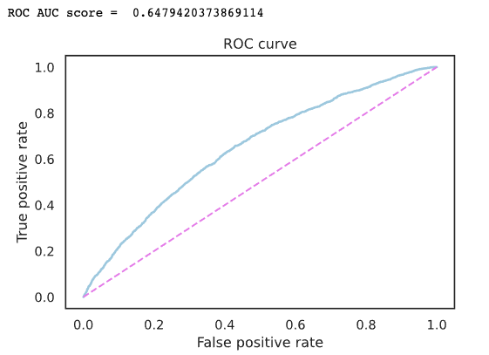
Visualization

Slide 6
Next Steps
Improve R-squared of multiple regression model
Create streamlit app containing process and results

